Slide 1
White Point Landslipe Palos Verdes, CA
By Christian Kesler, Savannah Keane, and Sarva Pulla

Slide 2
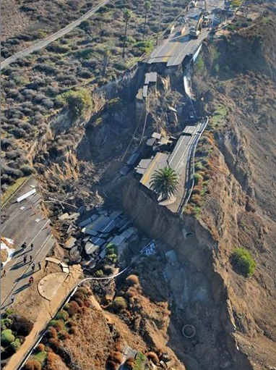
Site information
Palos Verdes, CA
On a bluff overlooking the Pacific Ocean
Roadway along top of the bluff

Slide 3
Before failure - 2011

Slide 4
After failure - 2013

Slide 5
After failure - 2014

Slide 6
After failure - 2015

Slide 7
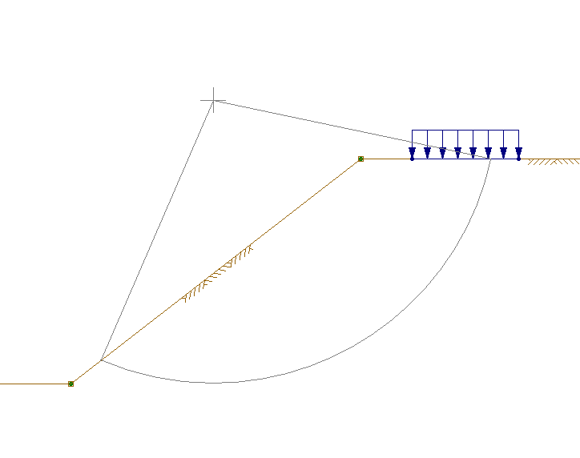
Utexas analysis before failure
Setup the location
Found distances and slope from Google Earth
Distributed load for the roadway

Slide 8
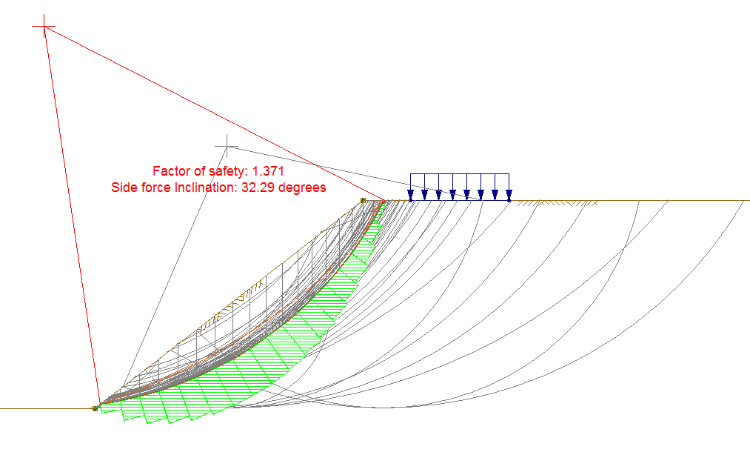
Utexas analysis before failure

Slide 9
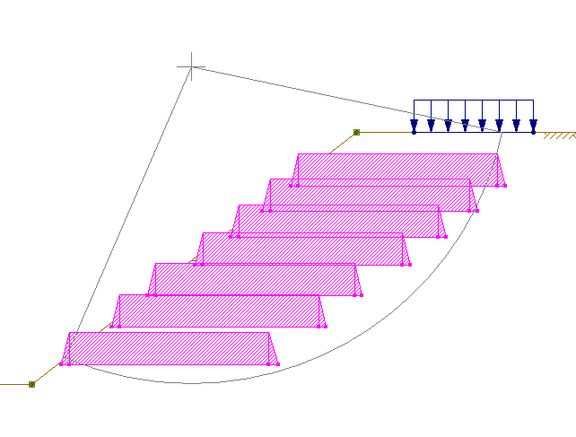
Utexas pre-emptive solution
7 Reinforcement Lines
108 feet in length
Total cost is approximately $453,000

Slide 10
UTExas pre-emptive solution

Slide 11
results
Actual failure OF SLOPE
pre-emptive failure with reinforcements
FS = 1.371
COST TO FIX = $32,000,000
FS = 1.465
COST TO PREVENT = $453,000

Slide 12
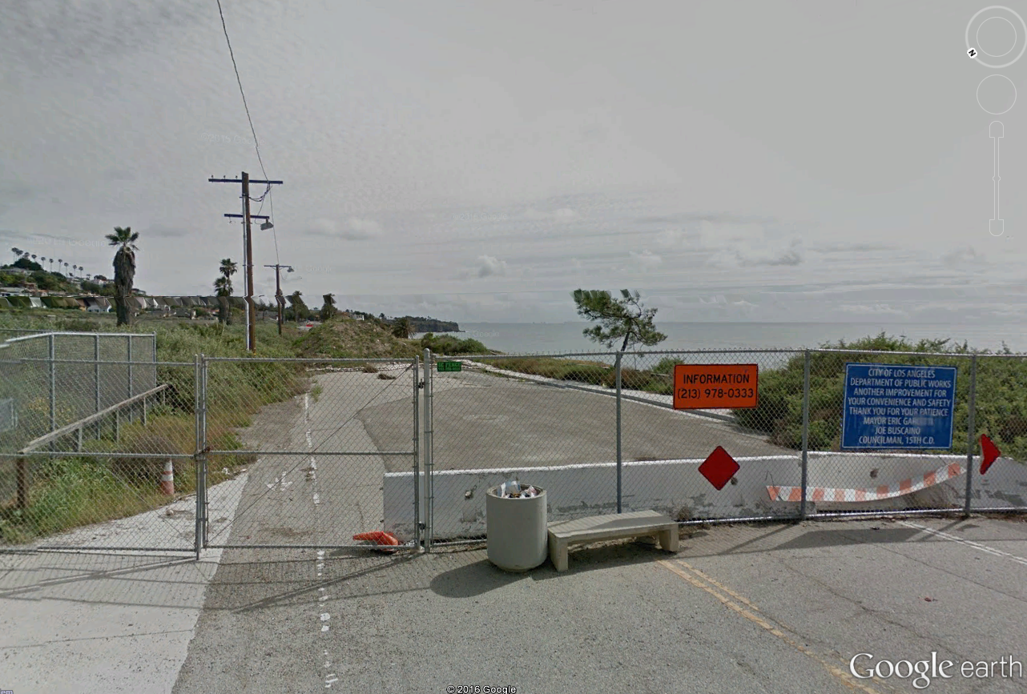
CURRENT CONDITIONS
Currently the road is blocked off on both sides of the slide
Construction to begin in 2019
Expected construction time is 2 years

Slide 13
Recommendations
Dewatering on the eastern flank
Slope anchoring using post-tensioned tieback anchors
Reinforced Soil Slope (Granular Fill with steel or geosynthetic reinforcement)
Retaining Wall
Bridge
Regrading

Slide 14
Potential costs
Immediate Measures (install monitoring points and drains, grade surface, and add slope anchors and traffic improvements) – $9.14 million. Option 1: Abandon Roadway – $0 Option 2: Restore road without a retaining wall – $43.8 million Option 3: Restore road with a retaining wall – $28.8 million Option 4: Restore road with a bridge – $51.3 million Option 5: Regrade road – $6.7 million Option 6: Reroute road – $6.9 million

Slide 15
END
References
http://eng.lacity.org/whitepoint/White%20Point%20Final%20Main%20Body.pdf
http://www.geotechdata.info/parameter/angle-of-friction.html
http://www.geotechdata.info/parameter/cohesion.html
http://www.geotechnicalinfo.com/soil_unit_weight.html

